Slide 1

Network Services
By : AASTHA VERMA
(E-ID : 152537)
Notes:
O Logo de espadas deve ter mais espaço das pontas abaixo. Sugerir outros tipos de imagens/ telefone, fones.

Slide 2
TOPICS TO BE COVERED
DHCP
Proxy Services
Mail Services

Slide 3
DHCP

Slide 4
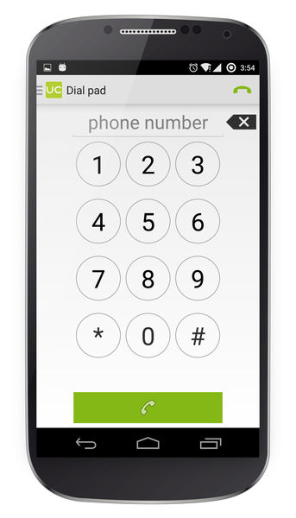

Phone Numbers
IP Address Allocation is somewhat relatable.
HOW ?
When a customer signs up for service, mobile phone companies assign a number from a pool of available numbers. Generally, these numbers are assigned at random, though sometimes a helpful employee may offer a choice of numbers to the customer. The available numbers are drawn from the blocks of numbers assigned through Bellcore/Telcordia and NANPA and consist of numbers not currently in use or which have not been used within the preceding 90 days.

Slide 5
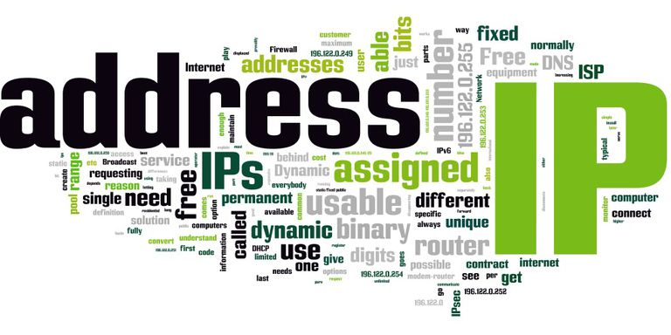
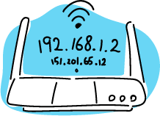
IP Address
Logical Addresses for network nodes (PC, switch, routers, etc.) to identify them uniquely in the network.

Slide 6
Types :
DYNAMIC :
Temporary Addresses
These IP addresses are assigned to a computer when they get connected to the Internet each time.
Actually borrowed from a pool of IP addresses, shared over various computers.
Static
IP
Dynamic
IP
Since limited number of static IP addresses are available, ISPs usually reserve the portion of their assigned addresses for sharing among their subscribers in this way.
STATIC :
Kind of Permanent Addresses
(change by Network Administration)
Static IP addresses are considered as less secure than dynamic IP addresses because they are easier to track.

Slide 7
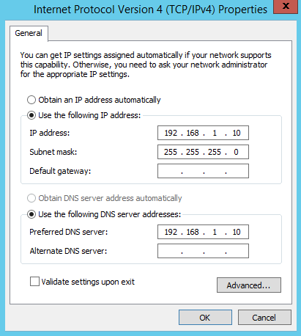
Address Allocation : MANUAL

Slide 8
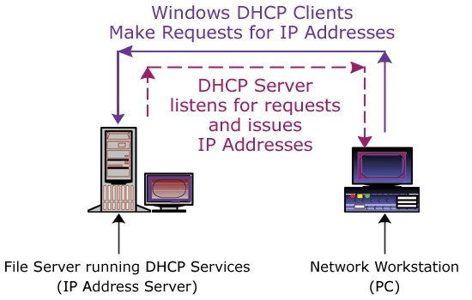
Address Allocation : DYNAMIC (DHCP Protocol)
Dynamic
Host
Configuration
Protocol

Slide 9
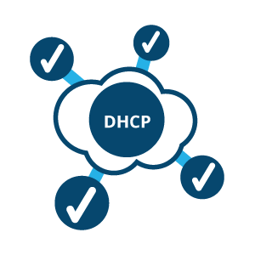
DHCP
Used to automatically deliver IP addressing.
Reduces the amount of time you spend configuring computers on our network
Used by default (now) unless you specify otherwise.
The ipconfig /all command will indicate whether the configuration came from a DHCP server computer.
Technical name – RFC2131

Slide 10
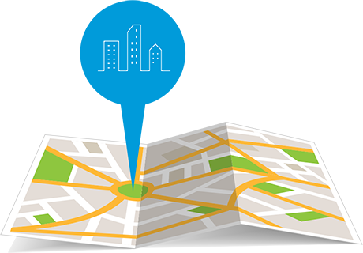
DHCP Address Allocation Methods
Dynamic Allocation
Given IP address is revocable.
IP address is given from a Pool (range of IP addresses) at the server, on a LEASE methodology.
Automatic Allocation
Same method as Dynamic Allocation
Given IP address is never revoked.
Manual Allocation
The address is allocated based on user’s request.
The address could be out of the DHCP allocated pool.
Also Permanent as Automatic Allocation

Slide 11
Technologies prior to DHCP
BOOTP
RARP
ARP
ARP (RFC826)
Address Resolution Protocol
Maps known IP address to
unknown MAC address
RARP (RFC903)
Reverse ARP
Early protocol for dynamic IP address assignment
Very limited – does not support assigning name servers and default gateway.
BOOTP (BOOTstrap Protocol)
Defined to overcome the limitations of RARP.

Slide 12
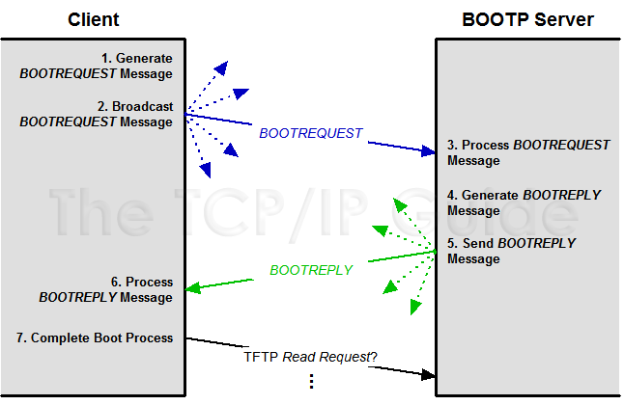
BOOTP
Client Creates Request
Client Sends Request
Server Receives Request and Processes it
Server Creates Reply
Server Sends Reply
Client Processes Reply
Client Completes Boot Process

Slide 13
Then why DHCP ?
DHCP is an extension to BOOTP, defined to fix the limitations of BOOTP :
IP Address lease (time)
BOOTP assigns IP addresses without a lease time.
In order to free an IP address assigned by BOOTP, a host needs to be rebooted.
In DHCP, an IP address is assigned to a client only for a limited (but extensible) time. If the IP address is not renewed it goes back to the pool of free IP Addresses.
Vendor Options

Slide 14
DHCP Message Types
Type identified by value field of OPERATION CODE in the
Operation Code (8) | Hardware Type (8) | Hardware Length (8) | Hop Count (8)
Transaction ID (4 bytes)
Number of seconds |  | Flag (1) : 15 unused bits
Client IP Address (4 bytes)
Your IP Address (4 bytes)
Server IP Address (4 bytes)
Gateway IP address (4 bytes)
Client Hardware address (4 bytes)
Server name (4 bytes)
Boot filename (128 bytes)
Options (upto 312 bytes)
DHCP PDU
DHCPDISCOVER (1)
DHCPOFFER (2)
DHCPREQUEST (3)
DHCPDECLINE (4)
DHCPACK (5)
DHCPNACK (6)
DHCPRELEASE (7)
DHCPINFORM (8)

Slide 15
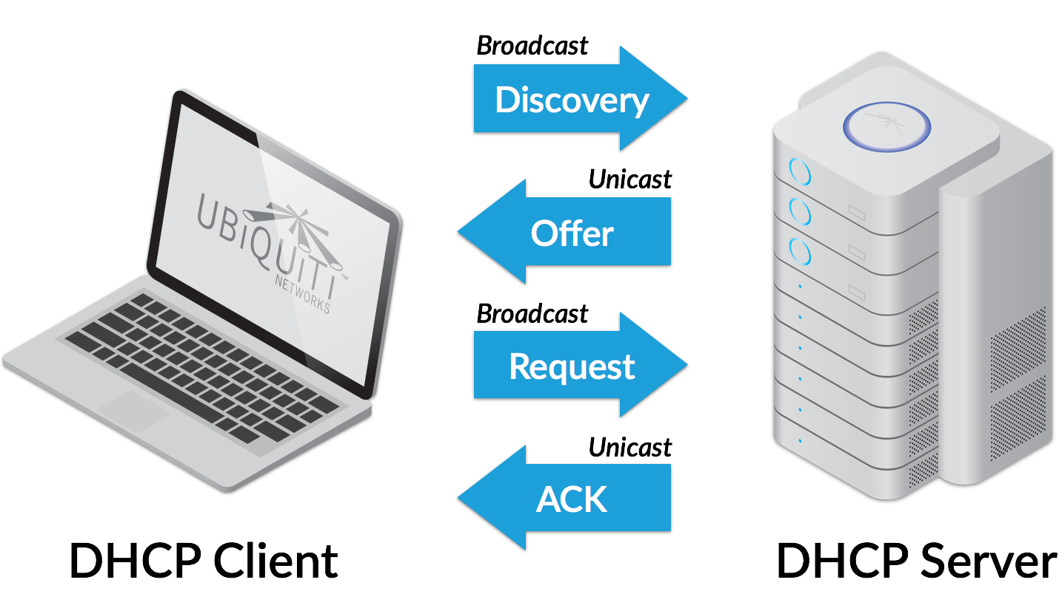
Leasing an IP Address
DORA
An IP Address is leased during the boot process.
The overall process is composed of 4 broadcast packets :
DHCPDISCOVER (1)
DHCPOFFER (2)
DHCPREQUEST (3)
DHCPACK (5)

Slide 16
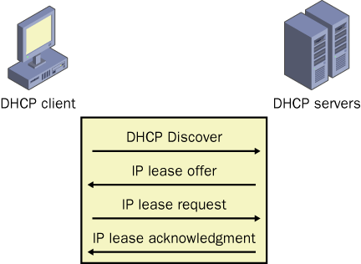
Leasing an IP Address
Any DHCP server that receives the DISCOVER packet responds with an OFFER packet.
The DHCP client responds to the OFFER packet it receives with a REQUEST packet
An ACK (acknowledgement) packet indicates confirmation that the client can use the lease.
Once the ACK is received, the client can start using the IP address and options in the lease.

Slide 17
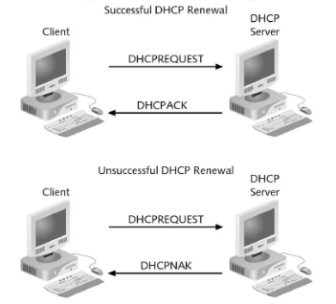
Renewing an IP Address
The IP address can either be permanent or timed (based on allocation method deployed).
A permanent address is never used for another client.
Timed lease expire after a certain time.
Windows clients attempt to renew their lease after 50% of the lease time has expired.
A DHCP server may honor or reject a renew request.

Slide 18
Some extra bits
Backward compatible with BOOTP : static configuration
Uses client-server model.
PORTS :
67 – connections to server
68 – connections to client
DHCP was created by Dynamic Host Configuration Working Group of the Internet Engineering Task Force (IETF).
Runs over UDP.
Can you guess why? : DHCP server uses 2 Databases

Slide 19

Topic End

Slide 20
PROXY
SERVICES

Slide 21

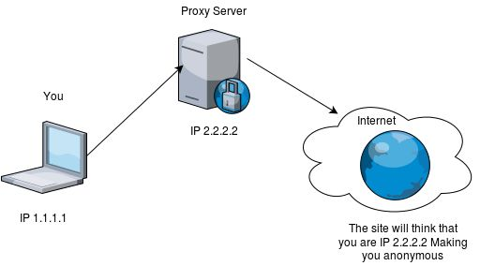
What is Proxy ?
A Proxy server is a dedicated computer or a software system running on a computer that acts as an intermediary between an endpoint device.
To the user, the proxy server is invisible, all Internet requests and returned responses appear to be directly with the addressed Internet server.
FORMAL MEANING :
The authority to represent someone else, especially in voting and COLLEGE LECTURES.

Slide 22
Why Proxy Server
To share Internet connection on a LAN.
To speed up Internet surfing.
To hide the IP address of the client computer.
To bypass security restrictions and filters.
To scan outbound content.
To stream internal content to Internet users.

Slide 23

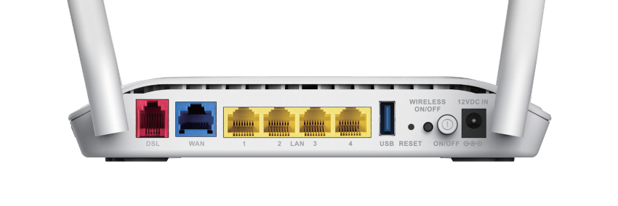
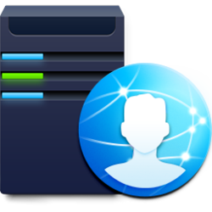

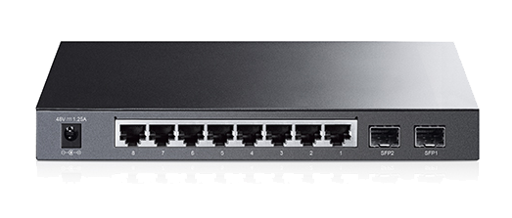



Modem
192.168.1.1
Airtel ISP
192.168.1.10
G : 192.168.1.1
How Proxy
Works ?
192.168.1.11
G : 192.168.1.1
192.168.1.12
G : 192.168.1.10
192.168.1.13
G : 192.168.1.10

Slide 24
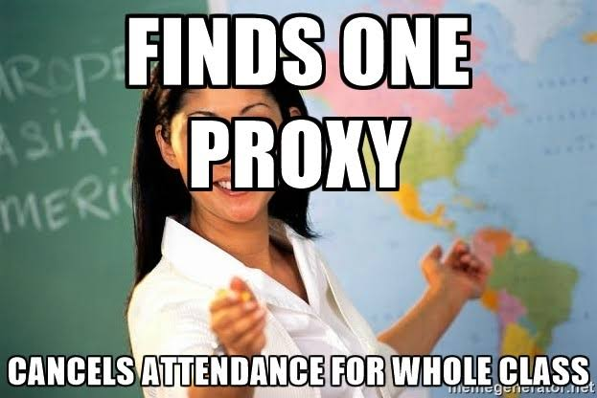
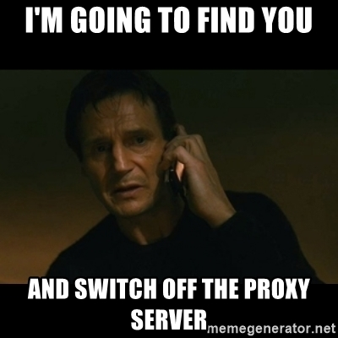
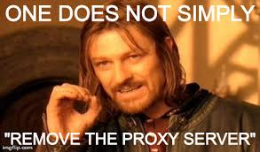
Pros & Cons !!

Slide 25
Topic End

Slide 26
EMAIL SERVICES

Slide 27
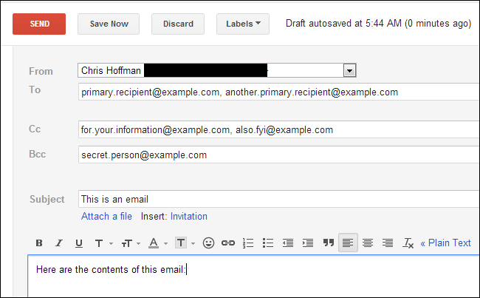
Email Structure
From : YOU
To : (blank)
Cc : All important stakeholders
Bcc : Whole list of Invitees (to whom invitations are to be sent)

Slide 28
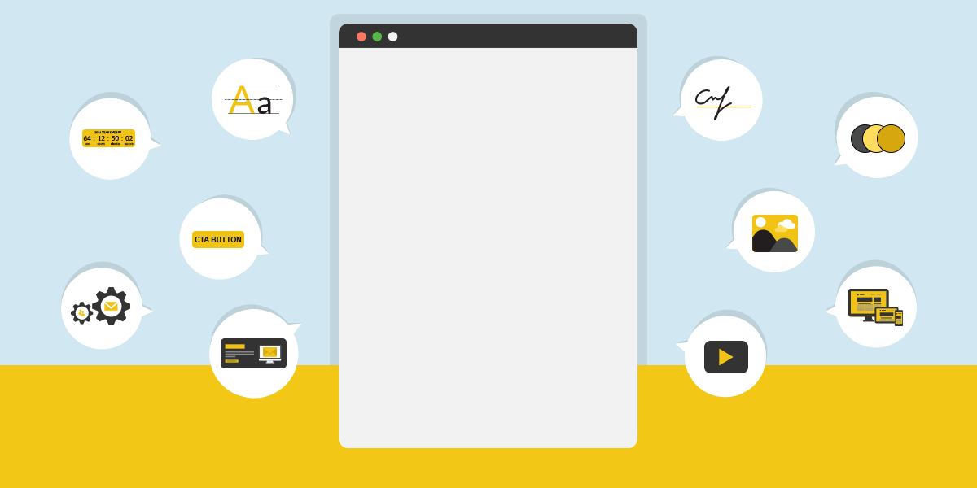
The Past, Present and Future of Emails

Slide 29

1980s
‘82 – EMAIL word
‘82 – SMTP
‘88 – Ist Commercial, Microsoft Mail MMM
1970s
‘71 – Ray Tomlinson
Ist N/w MAIL
ARPANET
‘77 – Standard Format
‘77 – US Postal Service
THREAT TO MAIL
1960s
‘65 - Email is introduced at MIT
‘89 – CompuServe
‘89 – IBM Lotus Notes 1.0

Slide 30
Early 1990s
Early 90s – Email spam
’92 – MS Outlook for MS-DOS
Late 1990s
‘97 – MS Outlook 97 (Central Hub that includes email, scheduling, contact mgmt, task mgmt & a journal module.
2000s
2000 – MS introduces Entourage mail for Mac.
2003 – MS Outlook 2003 introduces junk mail and phishing filters & multiple user accounts.
‘93 – AOL & Delphi connect their proprietary email systems to the Internet
‘93 – BellSouth & IBM : Simon Personal Communicator (World’s first mobile phone with PDA features, including email capability)
‘98 – MS Outlook 2000 (ability to customize & incorporate personal, corporate & Web based info in 1 place).
Late 90s – HTML email
‘96 – Sabeer Bhatia and Jack Smith launch “HoTMaiL”.
‘98 – “You’ve got Mail”.
‘97 – Yahoo! Mail.
2004 - The Federal Trade Commission codifies email spam laws.
2006 – Outlook 2007 released, with native support for RSS feeds & the ability to receive text messages.
2006 - FACEBOOK

Slide 31

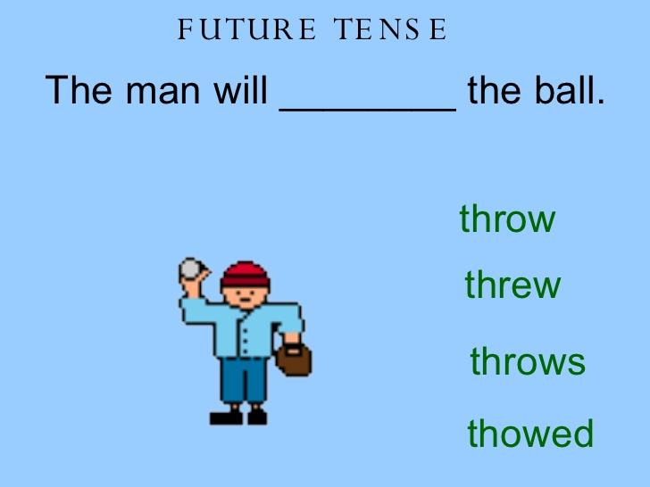
MS Outlook 2010
Outlook Mobile
FB* – MS Office Web Apps into msg system
Associated Press Stylebook changes ‘e-mail to ‘email’.
Personali-zation
Email
+
Social
Interactivity

Slide 32
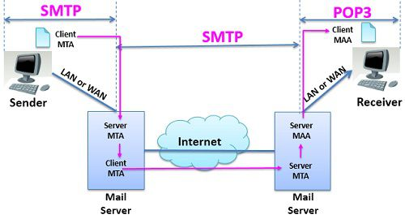
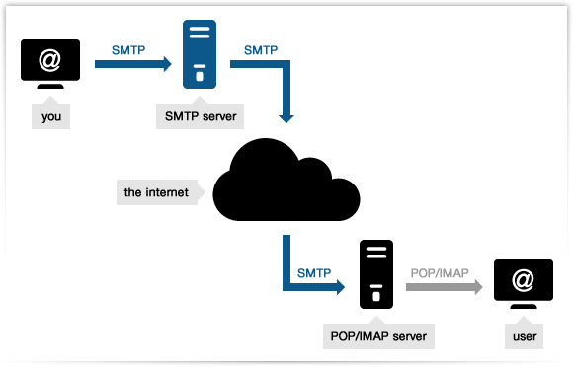
Overview : SMTP

Slide 33
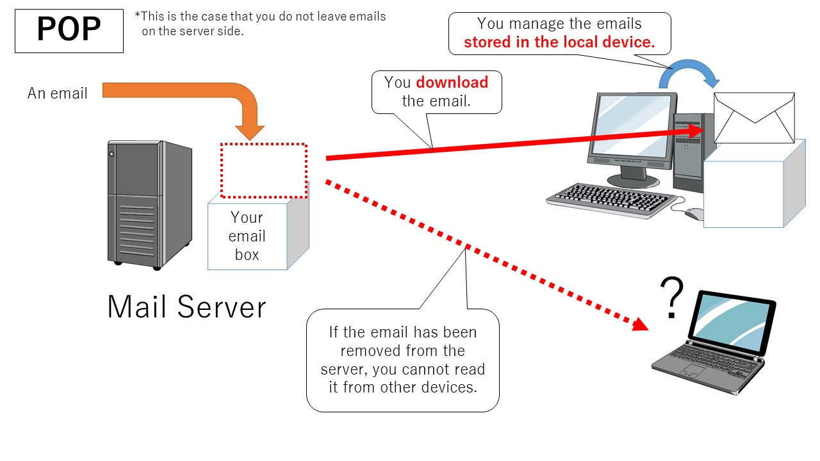
Overview : POP3

Slide 34
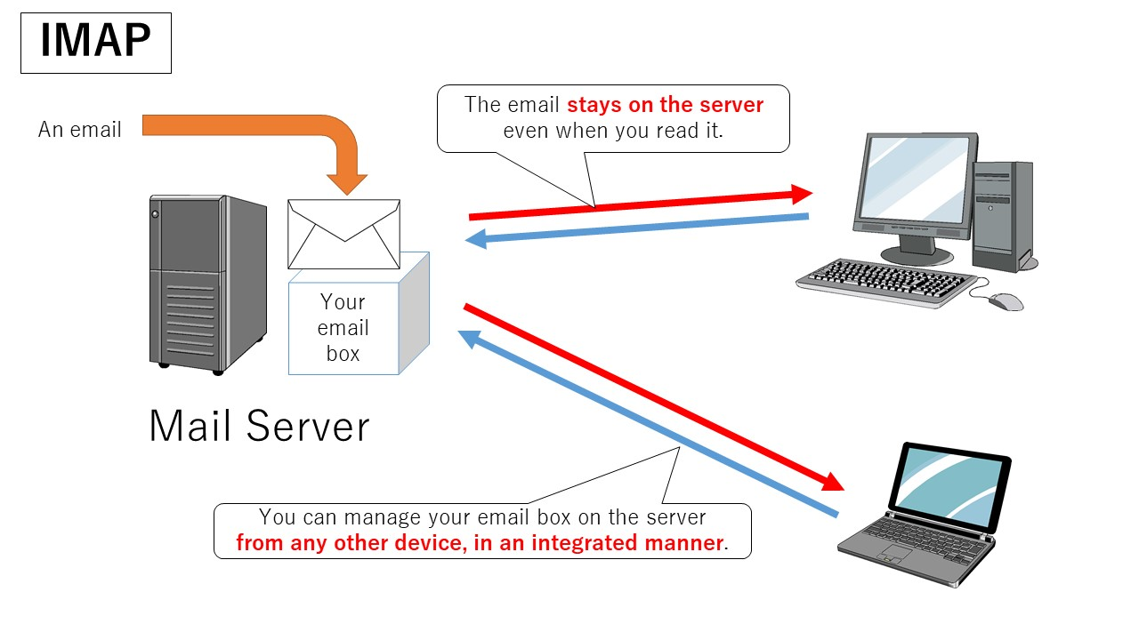
Overview : IMAP

Slide 35
Topic End

Slide 36
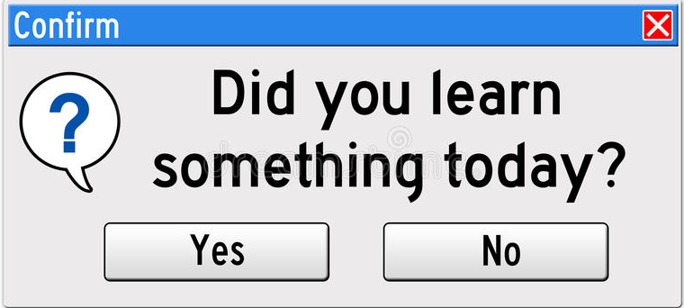
If (answer==“YES”) {
System.out.println (“THANKS”);
}
Else {
System.out.println(“To err is human, to forgive is not company policy”);
}

